Slide 1
Custom Open Source Intelligent Application - DIAGNOSIS OF POLYCYSTIC OVARY SYNDROME
ITMS-548 Cyber Security Technologies Prof. Maurice Dawson Jr., Ph.D.
By Abhishek Panjwani and Aryan Ramesh Prasad Nov 29th, 2024

Slide 2
Team Members
Abhishek Panjwani
Aryan Ramesh Prasad

Slide 3
Scope of this Project
Diagnosis of Polycystic Ovary Syndrome (PCOS) Using Machine Learning
1. Purpose:
Develop a data-driven tool to diagnose PCOS in women, leveraging a machine learning approach.
2. Data Source:
Utilize a dataset from Kaggle and other datasets with 43 attributes from 541 women, including 177 diagnosed with PCOS.
3. Methodology:
Perform univariate feature selection to identify key predictive features, focusing on hormonal indicators.
Apply machine learning classifiers (e.g., gradient boosting, random forest, logistic regression, hybrid models) to develop a predictive model.
Validate the model using cross-validation techniques to ensure accuracy and reliability.
4. Deliverables:
A machine learning model capable of accurately diagnosing PCOS.
A report on the model development process, performance metrics, and validation results.
5. Impact:
Provide a reliable diagnostic tool for healthcare professionals to improve early detection and management of PCOS.

Slide 4
Financials
No cost is involved in this project, as we used Anaconda for free Python libraries and open-source analytical tools like Burpsuite, Project Plan 365, and Metasploit.

Slide 5
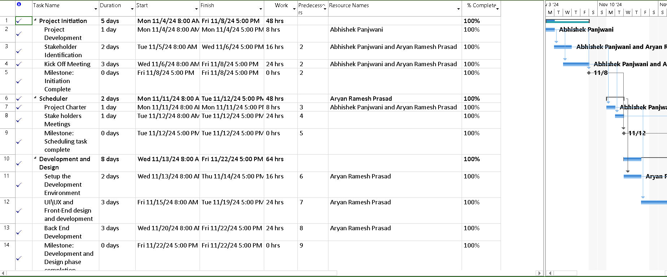
Project Plan and Scheduler

Slide 6
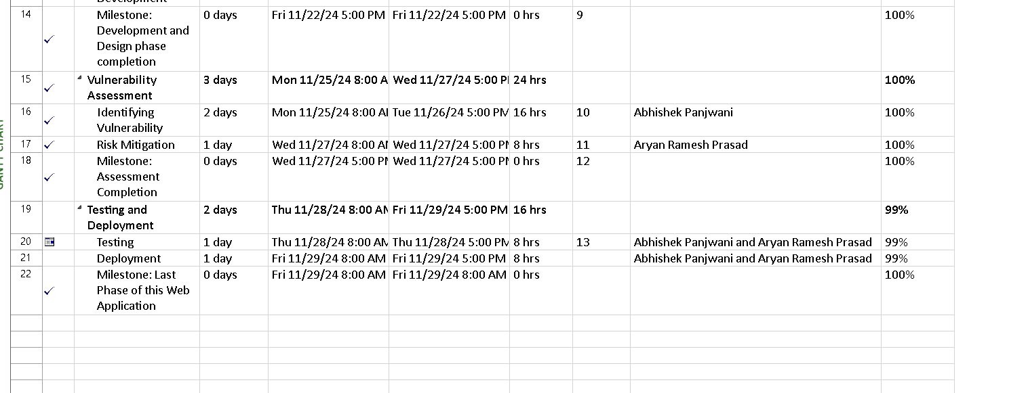
Project Plan and Scheduler

Slide 7
Project Plan and Scheduler

Slide 8
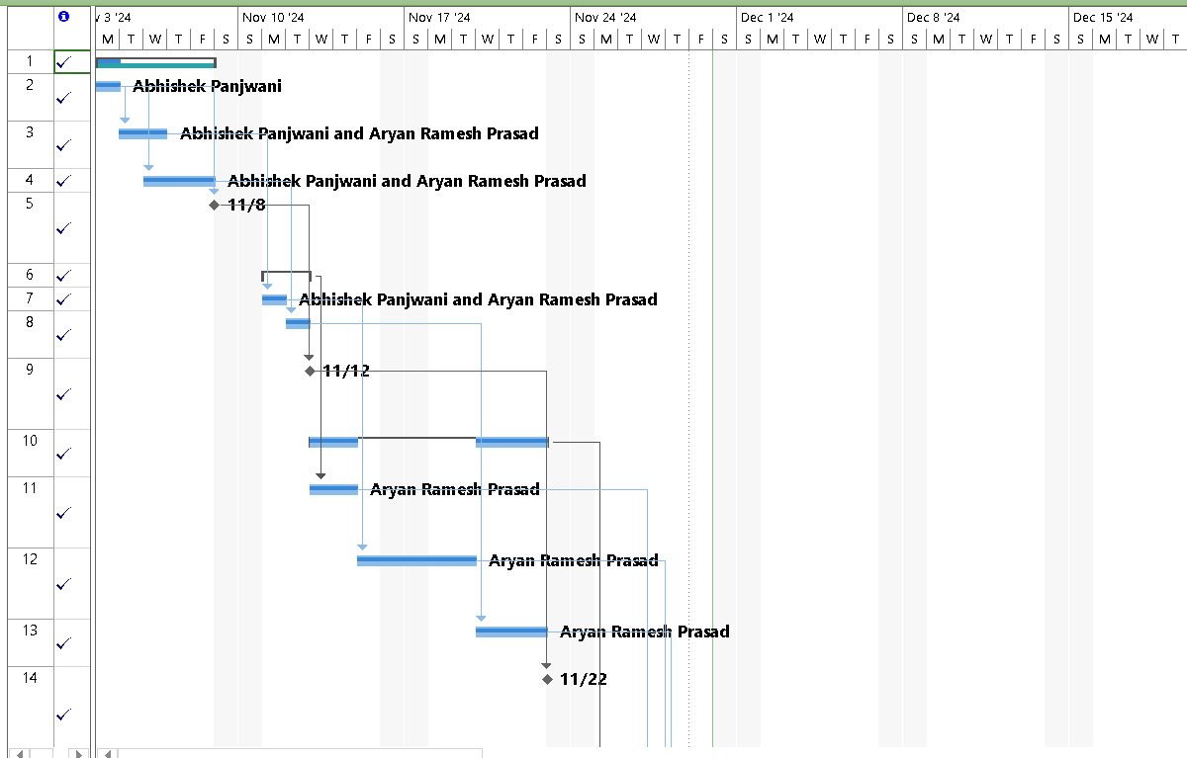

Gantt Chart

Slide 9
Communication Strategy and Tools
As we have Used the Agile Method for this Project, We used MS Teams for Team Collaboration and we a scheduled brief meeting “to do list” at 10 AM-10.30 AM.
And we collaborated at 3-4 PM every weekday to discuss the progress and prospects of this project

Slide 10
Project Risk
Risk Event:
Description: Data breach leading to unauthorized access to personal health data of users.
Risk Type:
Negative/Pure Risk: Classified as an adverse risk due to its potential to compromise user privacy and security, which can severely damage trust and result in legal repercussions.
Impact if the Risk Event Takes Place:
Description: A data breach could lead to loss of user trust, significant legal fines, and a tarnished brand reputation, impacting user retention and acquisition.
Risk Mitigation Strategy (Negative Risk):
Mitigation Approach: Implement robust data encryption, regular security audits, and compliance with global data protection regulations (e.g., GDPR, HIPAA) to minimize the risk of data breaches. Implement incident response plans and regular training for staff on data security best practices.
Risk Acceptance Level:
Approach: The potential impact on the organization's reputation and finances is acknowledged. Continuous monitoring and investment in security measures are prioritized, with regular updates to stakeholders about security practices.
Likelihood of the Risk Event:
Assessment: Given the sensitivity of health data, the occurrence is considered possible but not very likely (2 on a scale of 1-5), assuming state-of-the-art security measures are in place.
Risk Score Calculation:
Calculation: Risk Score = Probability (2) * Impact (4) = 8

Slide 11
The Inception of this Application
Problem Statement:
- Polycystic ovarian syndrome (PCOS) is one of the most common reproductive endocrinological disorders with a broad spectrum of clinical manifestations affecting about 6- 8% of women of reproductive years.
- However, it is important to make an early diagnosis in order to prevent early and late sequel of the syndrome.
- PCOS a diagnosis of exclusion has been a topic of debate and many consensus definitions have evolved over time.
- PCOS causes in ovaries inappropriate growth of follicles that are prevented at a primary stage and miscarry to mature.
- This is one of the causes for infertility. Therefore, it is significant to screen the patients at a primary stage to prevent any serious moment of the PCOS disease.

Slide 12
The Proposal
Proposed System:
- This project focuses on the data-driven diagnosis of polycystic ovary syndrome (PCOS) in women.
- For this, machine learning algorithms are applied to a dataset freely available in Kaggle repository.
- This dataset has 43 attributes of 541 women, among which 177 are patients of PCOS disease.
- Firstly, univariate feature selection algorithm is applied to find the best features that can predict PCOS.
- The ranking of the attributes is computed and it is found that the most important attribute is the ratio of Follicle-stimulating hormone (FSH) and Luteinizing hormone (LH).
- Next, holdout and cross validation methods are applied to the dataset to separate the training and testing data.
- A number of classifiers such as gradient boosting, random forest, logistic regression, and hybrid random forest and logistic regression (RFLR) are applied to the dataset.
- Results show that the first 10 highest ranked attributed are good enough to predict the PCOS disease.
- Results also demonstrate that RFLR exhibits the best testing accuracy of 91.01% and recall value of 90% using 40-fold cross validation applied to the 10 most important features.

Slide 13
Implementation
Implementation:
To implement this project we are using the following steps:
Dataset:
In this experiment, dataset is composed of Polycystic ovary syndrome is a disorder involving infrequent, irregular or prolonged menstrual periods, and often excess male hormone (androgen) levels. The ovaries develop numerous small collections of fluid called follicles and may fail to regularly release eggs dataset contains all physical and clinical parameters to determine PCOS and infertility related issues.
Feature Selection:
Feature selection is the procedure of taking some informative and significant features from a huge number of features. This can produce a better pattern characterization of multiple classes. Taking irrelevant features in the data can reduce the accuracy of the classification models. Feature selection can reduce overfitting and improve accuracy. One form of feature selection approach is the filtering-based univariate feature selection method which considers each feature independently that is with regard to the dependent variable. Each feature is scored individually on certain specified criteria and the features are then selected based on the higher scores or higher ranks.

Slide 14
Implementation-CONTD
Model Training:
For 10 features with 20-fold cross validation, a number of classifiers are used. With this condition, the classification accuracy obtained by k nearest neighbors (kNN), random forest, decision tree, light GBM (LGBM), adaptive boosting (AdaBoost), gradient boosting, logistic regression, multilayer perceptron (MLP), hybrid random forest and logistic regression (RFLR) are 69.87%, 87.83%, 85.18%, 88.58%, 85.96%, 88.75%, 86.52%, 83.22% and 90.01%, respectively. It can be seen that good accuracy scores are obtained by gradient boosting, random forest, logistic regression, and RFLR.
Metrics used to evaluate our model
In our project, we have chosen four key evaluation metrics to assess the performance of our regression models: Mean Squared Error (MSE), Mean Absolute Error (MAE), R-Squared Parameter, and Root Mean Squared Error (RMSE). These metrics are particularly pertinent to our problem because they provide comprehensive insights into the accuracy, precision, and goodness-of-fit of our regression models.
Mean Squared Error (MSE):
MSE quantifies the average squared disparity between actual and predicted values. We use MSE as it penalizes larger errors more substantially, making it sensitive to outliers, which is important for our dataset as outliers can significantly impact the performance of regression models.

Slide 15
Implementation-CONTD
Mean Absolute Error (MAE):
MAE measures the average absolute deviation between actual and predicted values. We include MAE as it provides a more balanced assessment of model accuracy compared to MSE, particularly in scenarios where outliers may have less influence on the overall performance.
R-Squared Parameter:
R-Squared Parameter indicates the proportion of variance in the dependent variable that is explained by the independent variables. This metric is crucial for understanding how well our regression models capture the variability in the target variable, providing insights into the goodness-of-fit.
Root Mean Squared Error (RMSE):
RMSE calculates the square root of the average squared difference between actual and predicted values. Similar to MSE, we use RMSE to assess the accuracy of our regression models, with the advantage of being in the same units as the target variable, facilitating easier interpretation.
We have experimented with various modeling techniques, including Logistic Regression, Random Forest, AdaBoost, Decision Tree, Gradient Boosting, LGBM, and KNN. Each modeling technique has its own trade-offs:

Slide 16

Download Anaconda for Python Libraries

Slide 17
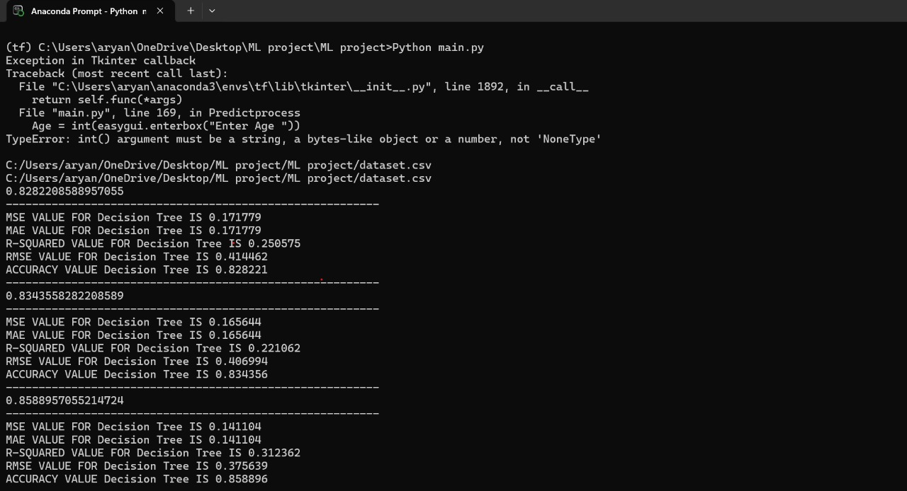
Hosting of application on local machine - Server

Slide 18
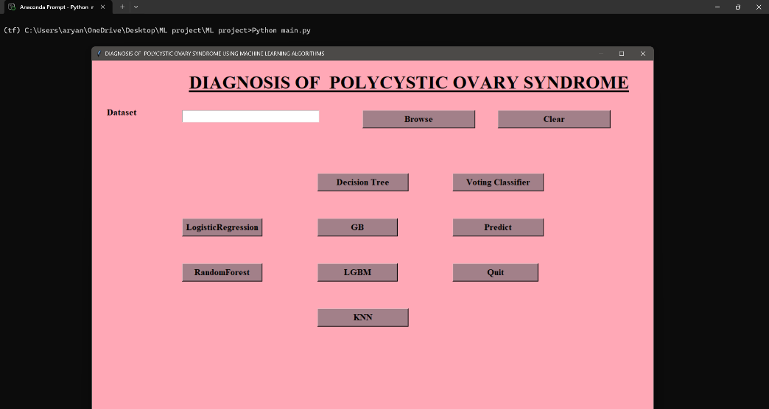
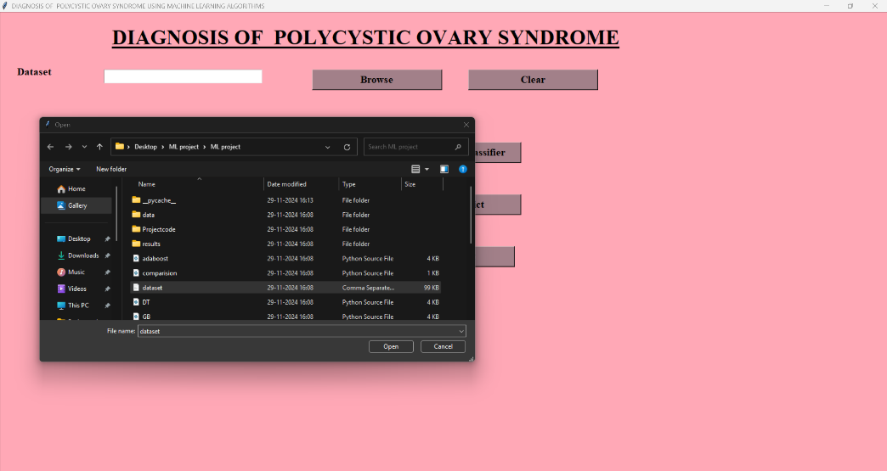
Webpage and Adding Datasets
This is how our page looks like
Datasets insertion

Slide 19
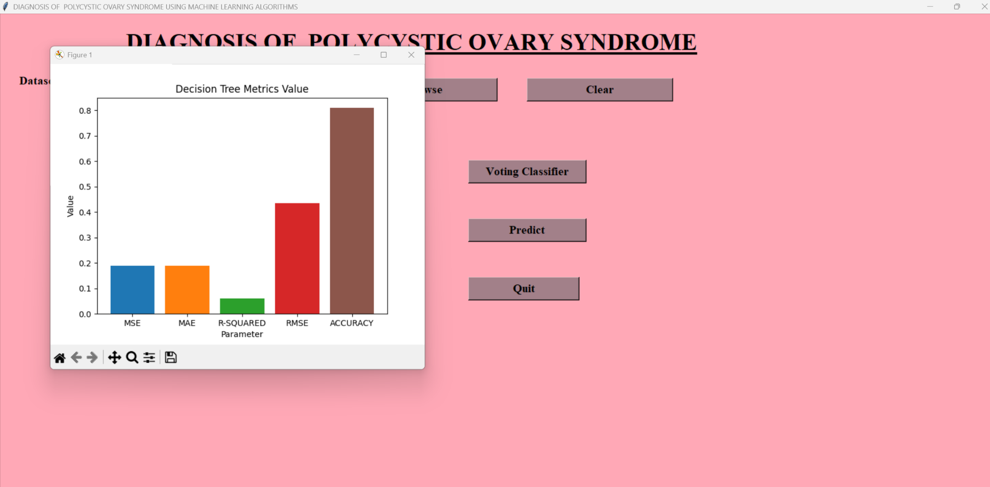
Data Analysis and Visualization

Slide 20
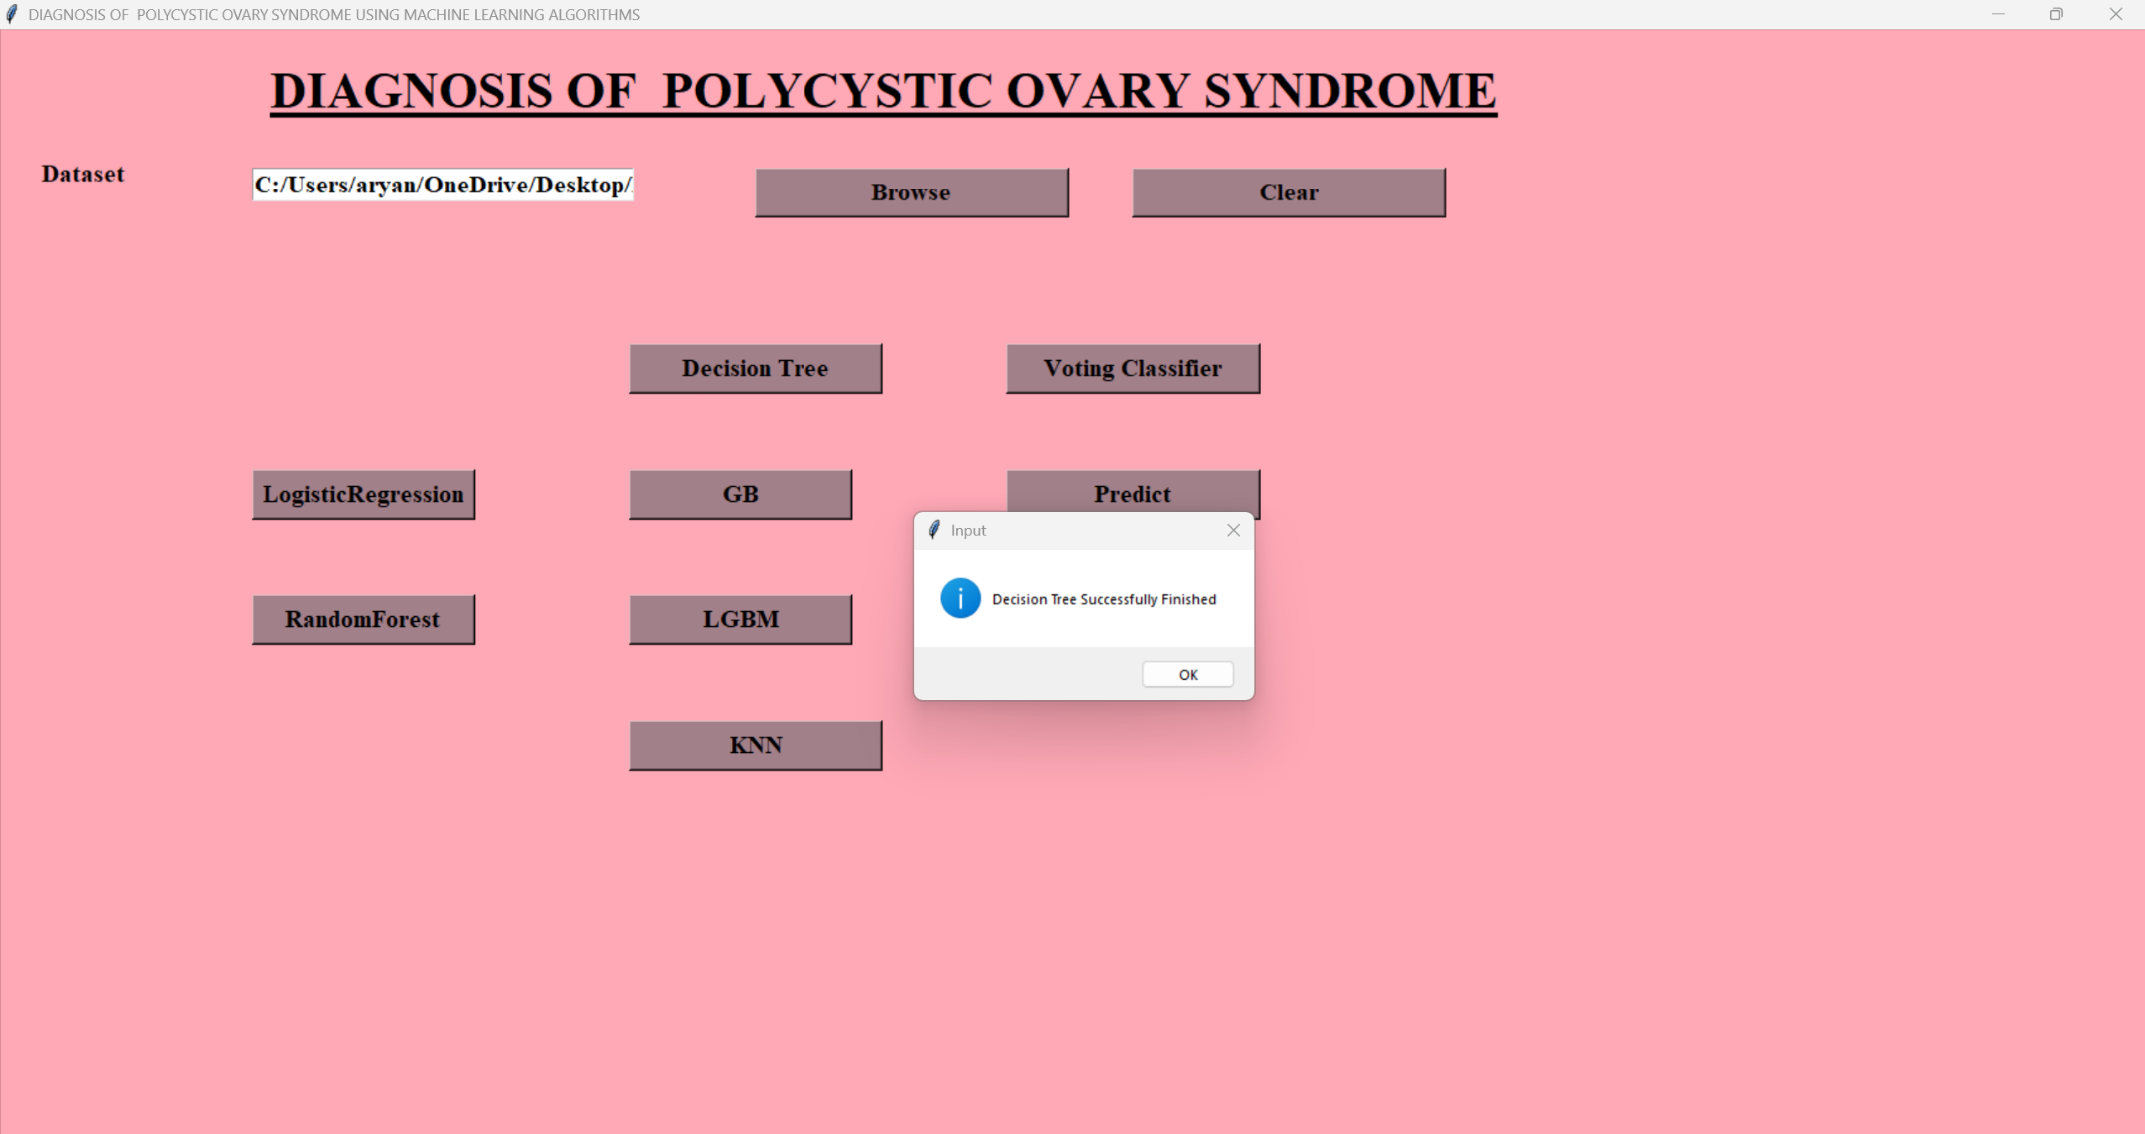
Data Analysis and Visualization

Slide 21
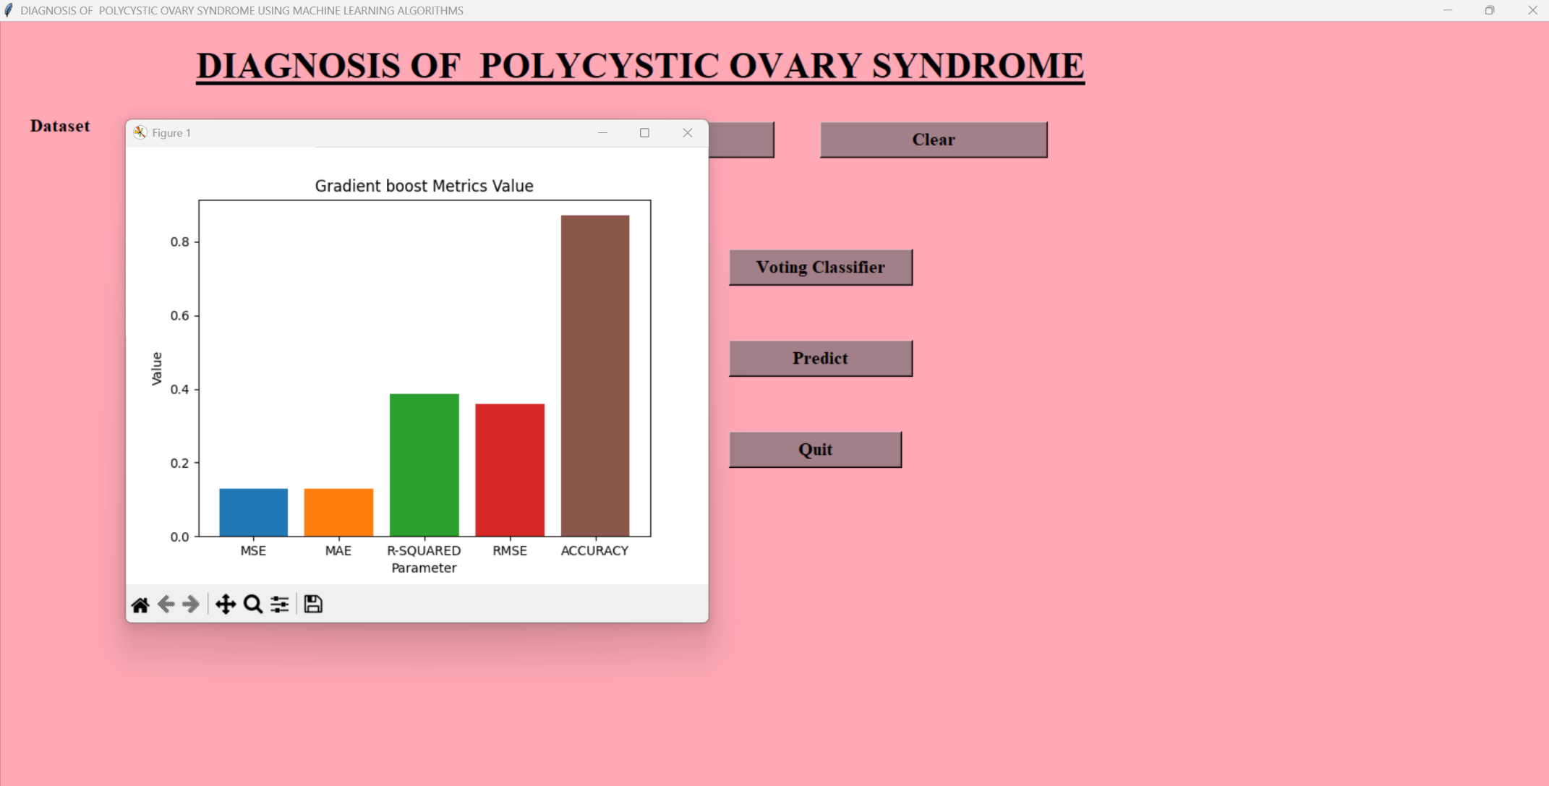
Data Analysis and Visualization

Slide 22
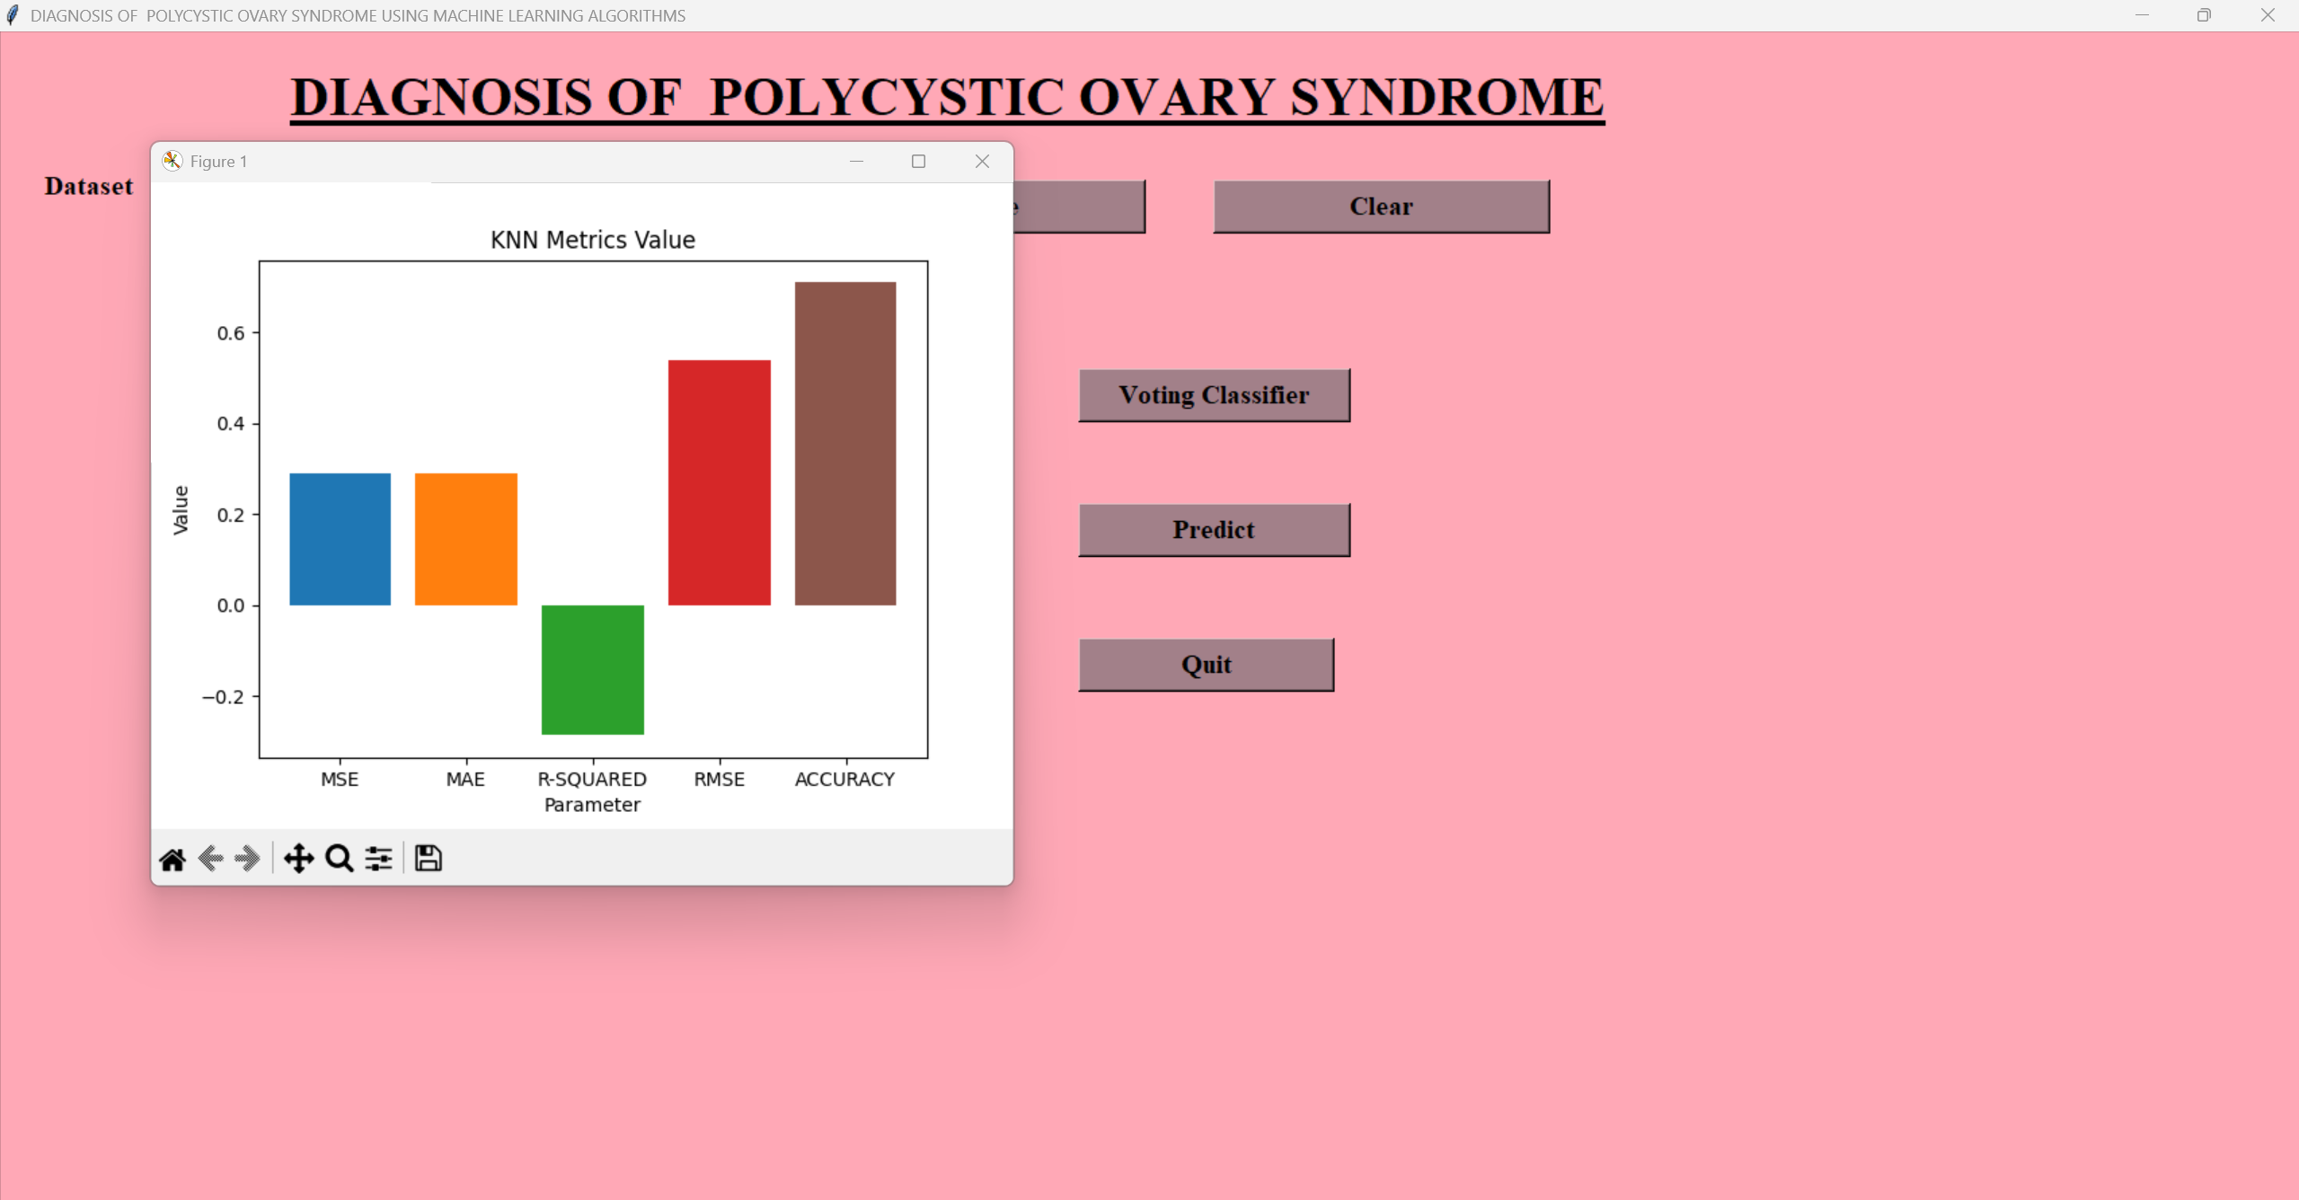
Data Analysis and Visualization

Slide 23
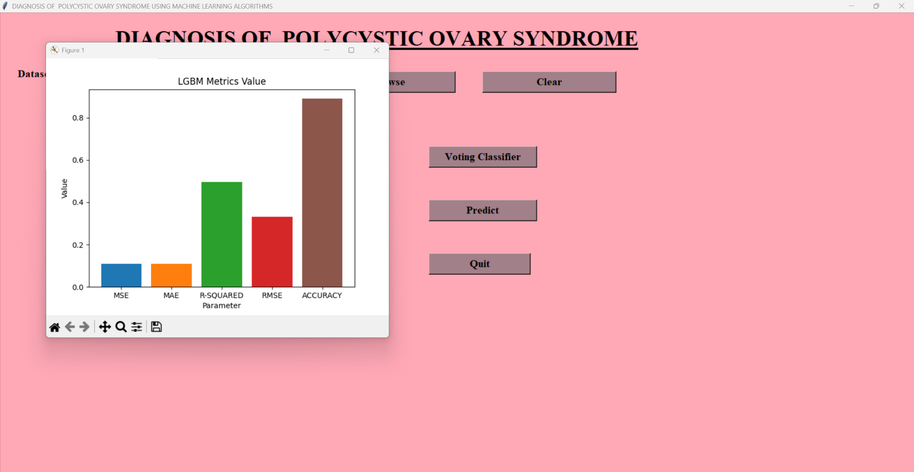
Data Analysis and Visualization

Slide 24
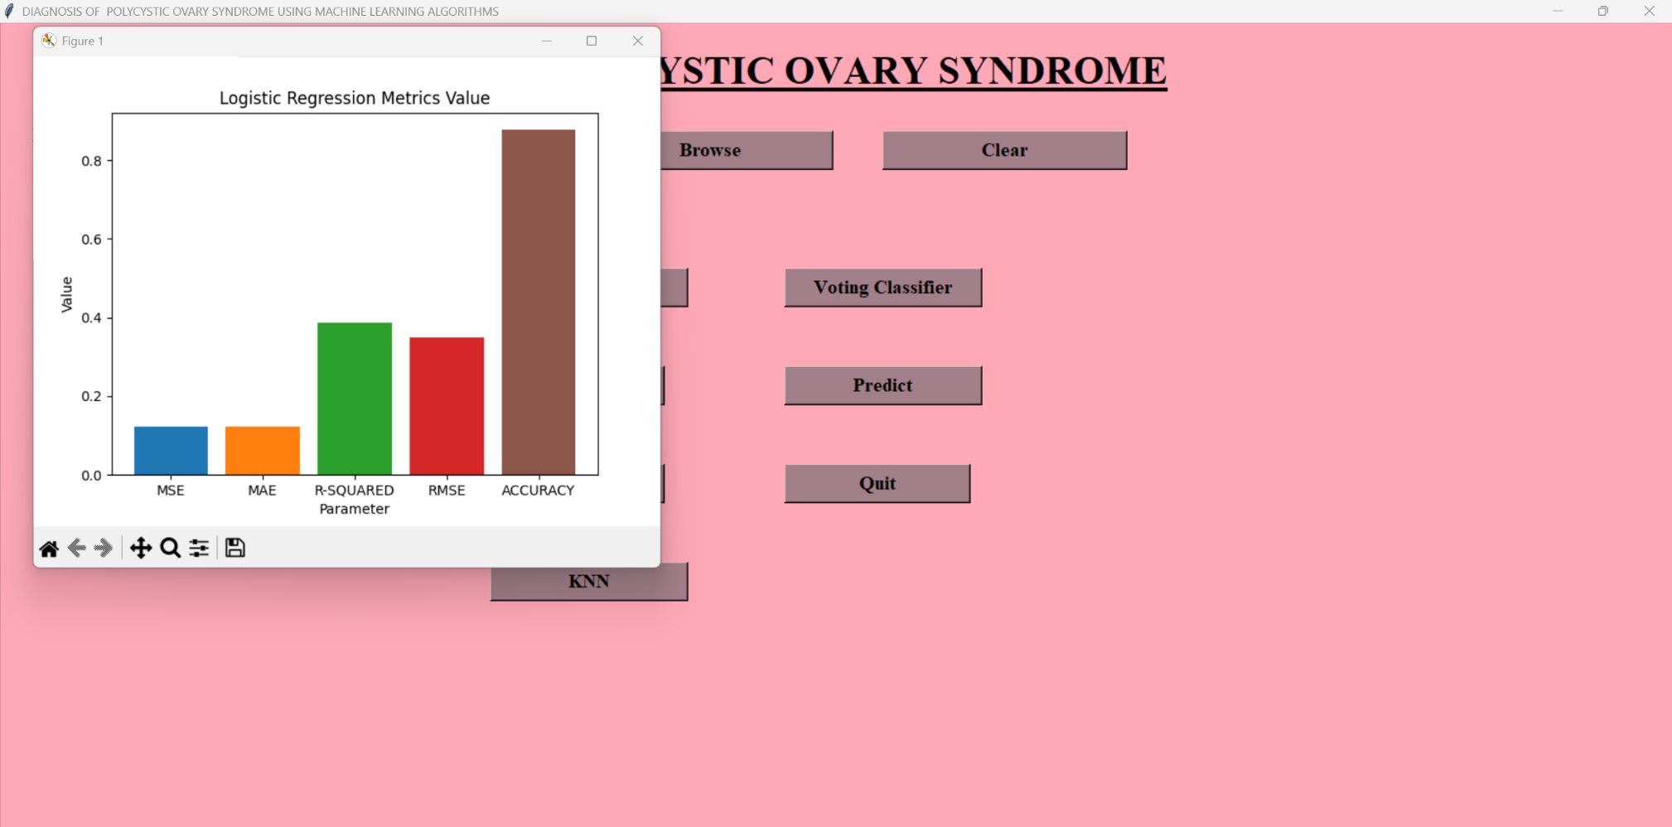
Data Analysis and Visualization

Slide 25
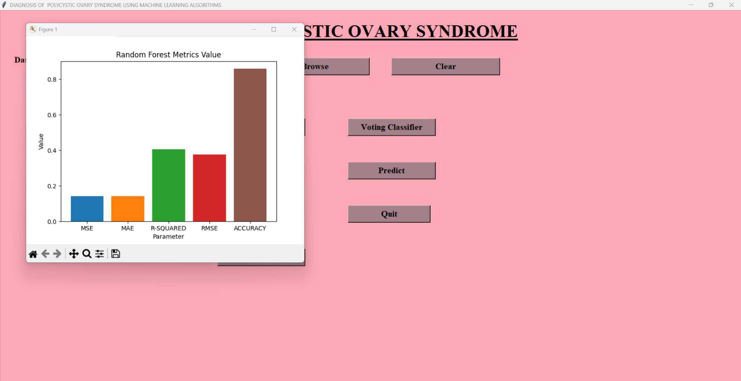
Data Analysis and Visualization

Slide 26
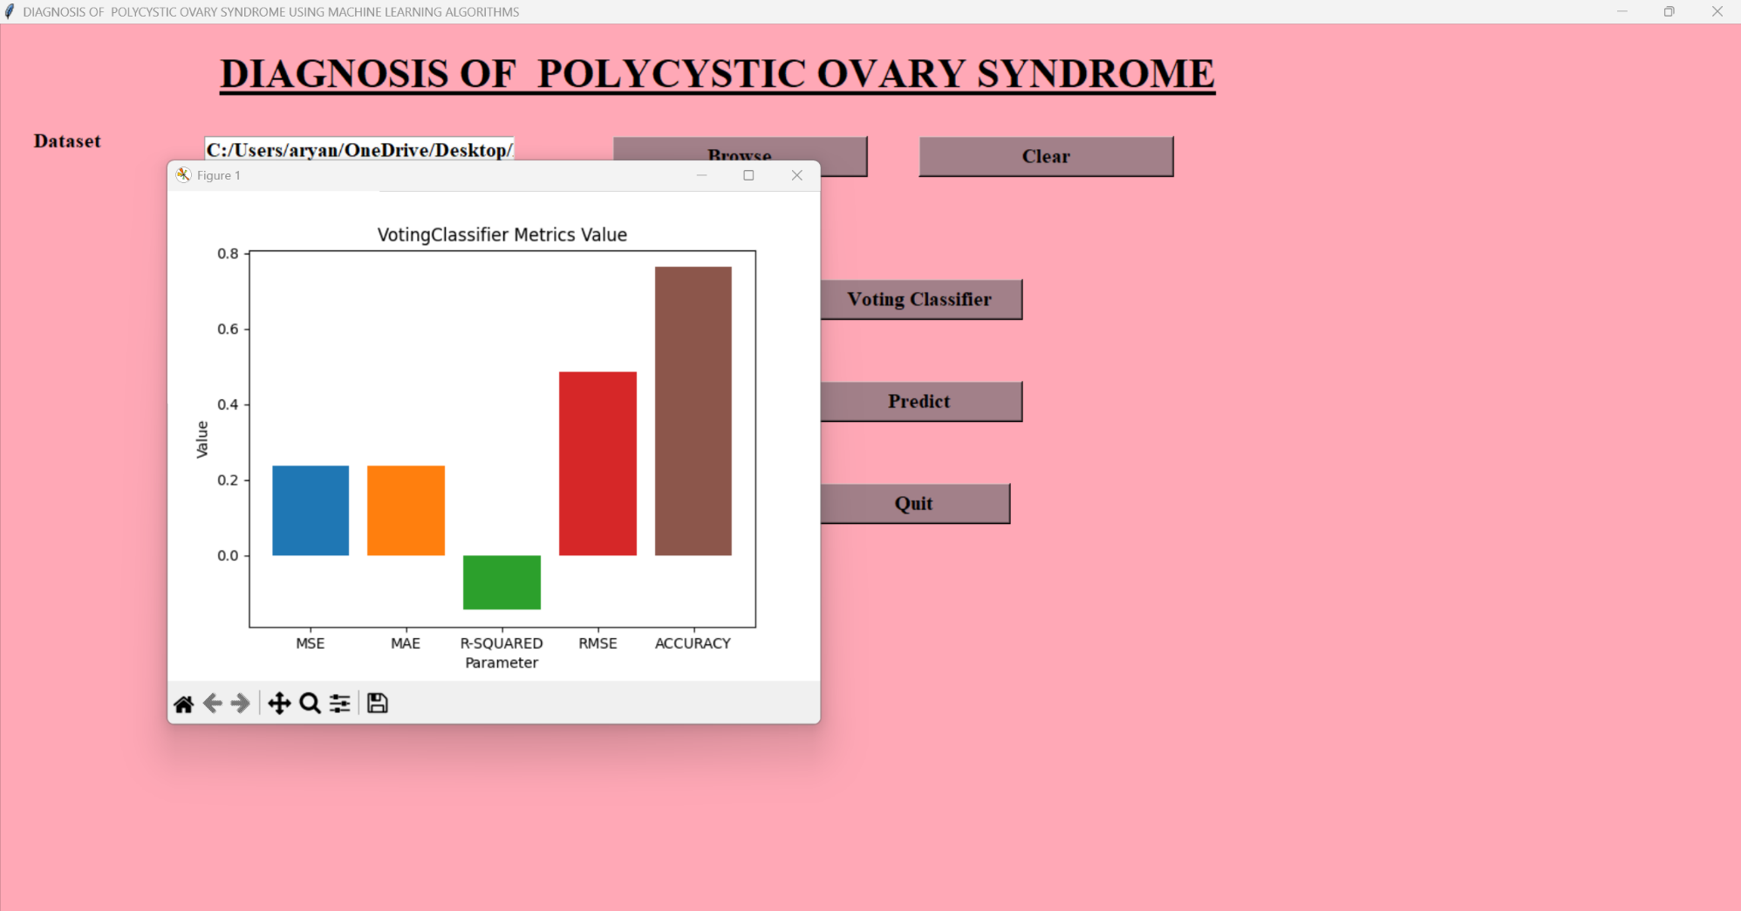
Data Analysis and Visualization

Slide 27
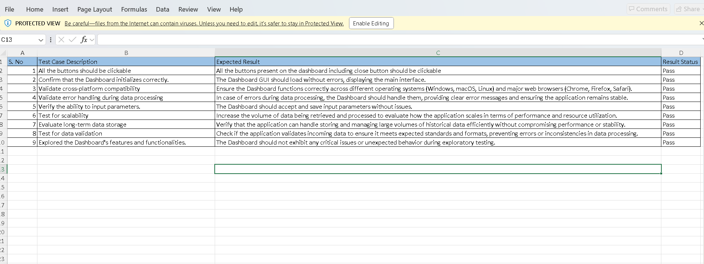
Test Cases

Slide 28
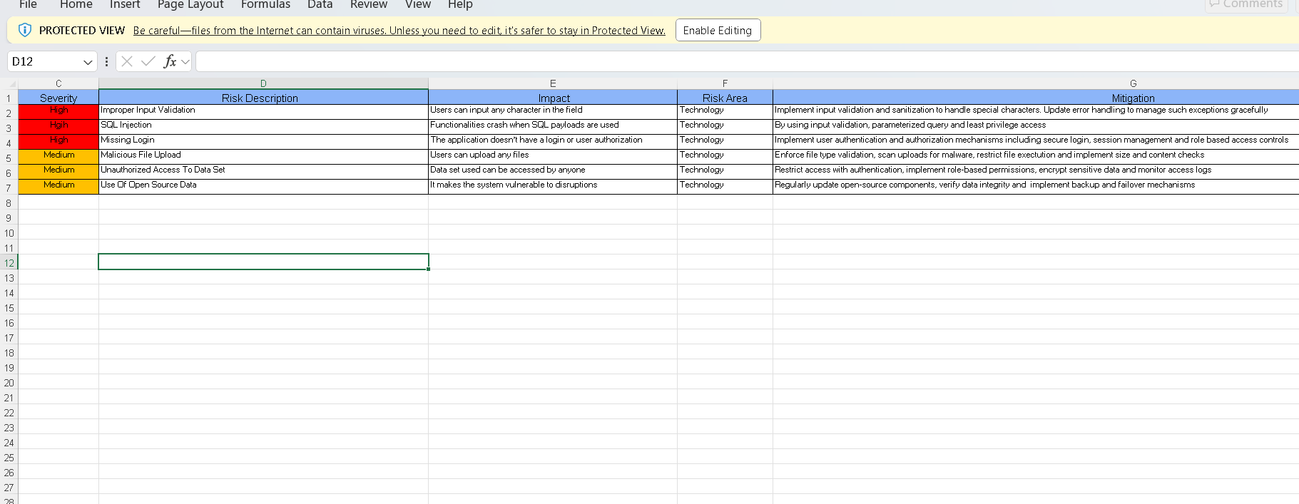
Risk and their Mitigation

Slide 29
Thank You

